Slide 1
A Level History Project Tips and Examples
By: Izzie Radford

Slide 2
Song
Analysis

Slide 3
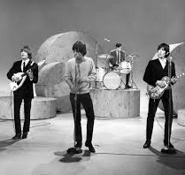
Instructions
For this assignment, you are going to pick 10 songs from the following genres: Country western, folk, R&B (Motown), movie or stage play themes, rock and roll, cutting edge funk, and ballads (big band or solo singers not rock and roll)
When you're looking up songs by genre, consider looking up "Best country songs of the 70s" or "Motown songs released in the 60s" or maybe even look up the billboard charts to see if you can find a song you know or that you want to write about.
Once you pick your 10 songs, you will find information regarding: title, singer, year introduced, genre, and a short synopsis of the song in a chart and a piece of trivia.
When you are including a piece of trivia, this means it could be something interesting about the production of the song, the way it was preformed, the artist, or how the song was used. Be creative and find something that is thought provoking, most people might not know about your song or artist, so this is a learning experience for everyone!
For your synopsis, it is helpful if you print out the lyrics and read them out loud. Make notes of what you think verses mean and annotate symbolism within the song. If you read it multiple times and still do not know it would be recommended to pick a different song, but if you really like that one, you can look up meanings to get little hints but make sure it is still your own interpretation.

Slide 4

Tips for Analysis
When analyzing the lyrics to your songs, make sure to follow the basics of analysis that you use in class. Use acronyms like Sally Makes Wine format to dig deep into what the songs say and what that means on a deeper plane. The point of this assignment is to connect the song to what is happening at the time the song was released. Because of this, you want to make sure that you are incorporating that into your analysis. Think about wars, social dilemmas, changes is fads, economics at the time, or political issues. Obviously, there is a lot more to connect to but those are some of the bigger ones to consider.
One thing that is helpful when writing analysis is to make just a few bullet points of facts from your source (in this case the song) and from those points, formulating your analysis. Having the bullets helps gather your thoughts and make an analysis that isn't all over the place.
Ex: Song- A Teenager's Romance by Ricky Nelson
  - From the show Ozzie and Harriet which is about a white family that gets into crazy situations but always ends up at their dinner table at the end of the day
  Discusses teen love and its standard emotions... it is the same for most people
  The song is centered by white suburbia and how each house and family are all copy and paste
  From these points, you can structure an analysis that discusses suburbia and how it is all the same, relate it to the time period!
Here are some analysis words of advice on the next slide, be sure to connect it to current times and make it your own! Everyone loves to hear what you have to say about the deeper meaning! -->

Slide 5
Key Words/How To
Sally Makes Wine from Vines and Juice
What do you See?
What does it Mean?
Why is it important?
What is the Value of the source?
What is your Judgement?
Words of Analysis
• This quote establishes that…
• This quote provides…
• The example proves…
• To further explain…
• The source concludes…
• This quote shows that…(be careful: use like demonstrates)
• This example suggests…
• The example demonstrates…
• This example reveals…
• The information exemplifies…
• From this example/source it can be determined that…
• This material supports the notion that…
• The author uses/explains/makes clear/develops…
• This contrasts with…
• This means…
Analyze/Analysis: | Evaluate/Evaluation:
Examine | Appraise
Study | Assess
Investigate | Calculate
Inspect | Check
Interpret | Classify
Dissect | Decide
Determine | Guage
Inquiry | Grade
Reasoning | Weigh
Search | Rate

Slide 6
Song: | I Got a Woman
Artist: | Ray Charles
Year Introduced: | 1954
Genre: | Soul/R&B
Synopsis: | This song by Ray Charles is another great American song. Like “Hallelujah, I Love Her So” this song deals with romance and having a strong woman partner. The interesting thing about this song is Charles sings “She give me money when I'm in need.” This is different than most other songs because in this case the female is a financial provider for the artist. In this era, the men were the ones who brought in the money and had the job so for Charles to be singing about a woman giving him money when he was in need was an interesting thing to share especially considering the time period. This was most likely because minority woman held the jobs as maids, iron ladies, or in childcare and sometimes it was harder for men to find work other than labor intensive jobs.
Fun Fact: | The well-known Kanye West remade this song in 2005 yet he completely skewed the song and titled it “Gold Digger” where the woman was using the man just for his money.
Song: | Goodbye Blue Sky
Artist: | Pink Floyd
Year Introduced: | 1979
Genre: | Rock and Roll
Synopsis: | Pink Floyd is known for their songs that create a discussion. “Goodbye Blue Sky” is just one of many influential songs from the album “The Wall.” This song is a farewell to peace during the war and an ode to the danger looming over the UK. The song references The Blitz (A German bombing campaign against the UK) and the lyrics, “Did you hear the falling bombs? Did you ever wonder why we had to run for shelter when the promise of a brave new world unfurled beneath a clear blue sky? ... The flames are all long gone, but the pain lingers on.” continue the recurring theme that because of this intense war, a farewell to the peace and blue skies they once knew is in order.
Fun Fact: | The Pink Floyd movie is a phenomenal collaboration of all the songs music videos to create a film. In “Goodbye Blue Sky” animation is used to compare musters and war in a captivating clip. The Film starts the protagonist Pink and how his life is driven to the dirt following the death of his dad and many awful events in his life.

Slide 7
Bad Example:
Song: I Got a Woman | Artist: Ray Charles | Year: 1954 | Genre: Soul/R&B | Synopsis: This song is by Ray Charles and it talks about romance. The woman in the song is the partner in the relationship that makes the money. Ray Charles is thanking her and showing his affection in this song. | Facts: Ray Charles was 73 when he died of complications from a liver disease. He was also blind toward the end of his career.
Why it's bad:
- In this example, the synopsis of the song contains no analysis and no specific information to the time period. The example states that the song is about romance and having a partner that has more money. Nowhere in the example does the person talk about social status in the 50s, the roles of women, or any details pertaining to the time period. There is no analytical language, and it is too surface level.
- The fun fact about the song has nothing to do with the information presented in the synopsis. The fact should be related to the information and be insightful.

Slide 8
Role play/ Dress up debate

Slide 9
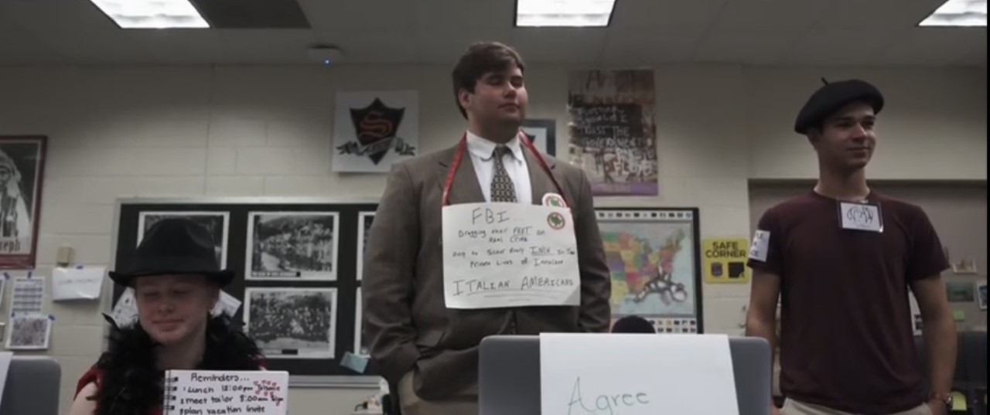
WHAT IT IS
In the dress up debate, you are going to be given a significant time period in which you will pick an influential person within that time period. Once you have selected your person and have been approved, you will be given a list of events in which you will do research. This research will be on your person and their beliefs on that events or if they had any involvement. Make sure that you choose a person that you know has a big enough platform where their views are known and can play a part in providing a different point of view to your class debate. You can pick someone that you might happen to know a lot about or you can pick someone that you might not know a lot about and through research and the debate you can get to know their stances even more and challenge yourself.
You will be doing research on your person and looking up their stances on political, social, economic, or cultural issues and debating as if you were them. Because of this, it is important to know your person's beliefs to a deep extent. On the following slide there will be tips for research and making sure that you have enough information.
You will also be required to have 5 props, a decorated name tag, your research and notes will be turned in, a minimum of 5 quotes, and make sure that you speak at least 5 times. The following is the point value for each category.
  Props and Name tag- 10 points
  Research and Notes- 30 points
  Research Quotes- 10 points
  Performance skills (embodiment of character)- 30 points
  Speaking 5 times- 20 points

Slide 10
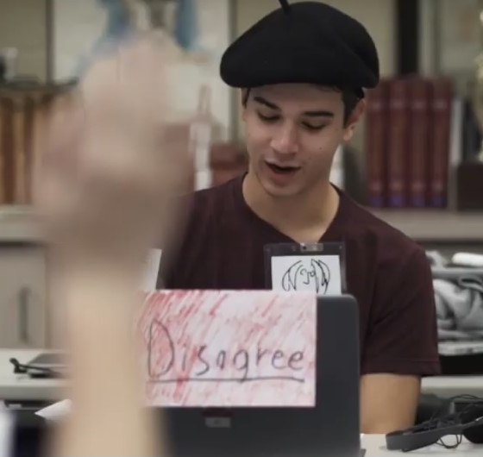
Tips for Research and Gathering Information
When researching your chosen person, it can be helpful to go by topic. Think to look up very specific details for example, "John Lennon's views on war," "John Lennon's political views." Get specific to make sure you not only find the right information but information that is applicable to the conversation. You want to make sure that you have too much information because you never want to be unprepared. It is better to be over prepared rather than under prepared, too much information never hurt anybody.
When you're researching, Dr. Crihfield will give you possible topics pertaining to the time period the debate is centered on. If you have a historical figure who is a politician, then most likely they will have an opinion on the subject, you can look up their name and their opinion on said historical event. However, if your person is someone that is more socially influential such as an actor, musician, or celebrity then they might not have an opinion on that specific event, yet they might have said something surrounding the topic. For example, if the subject is the War on Drugs and your person is a famous actor then you can look up their views on drugs such as if they are against them or if they frequently indulge.
In your debate you need to have direct quotes and quite a few of them. The quotes should apply to the topics and represent what your person believes. By using direct quotes in your points, it really helps support your view and make your argument stronger, so it is important to make sure you have a lot. Just like your research, it is better to have too many quotes than not enough.
Make sure you include your sources!! People can question where you got your information and it is always important to be prepared to provide a reliable source!!

Slide 11
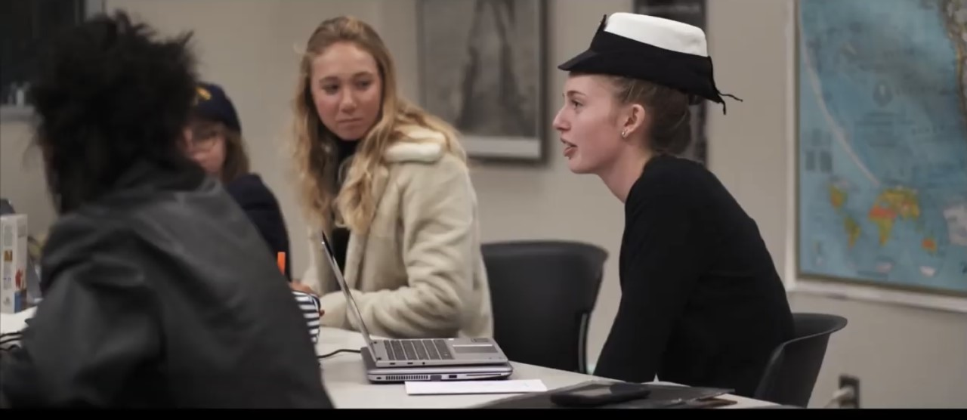
Making a Costume and Props
For this assignment you are required to have 5 props ready on the day of your debate. When putting together your costume and props, it is always helpful to look up pictures of your person and pick out things that they commonly wear or something that they always have with them. You are supposed to have 5 props but the props can be a part of your costume. For example, if you were to go as Elton John you could wear some funky sunglasses, bring a microphone, a tiny piano, a pride flag, and wear an Elton John inspired outfit. Make sure you get creative with your outfit and don't be afraid to use symbolism in your props as well, when looking at you someone should be able to somewhat determine who you are without your name tag!

Slide 12
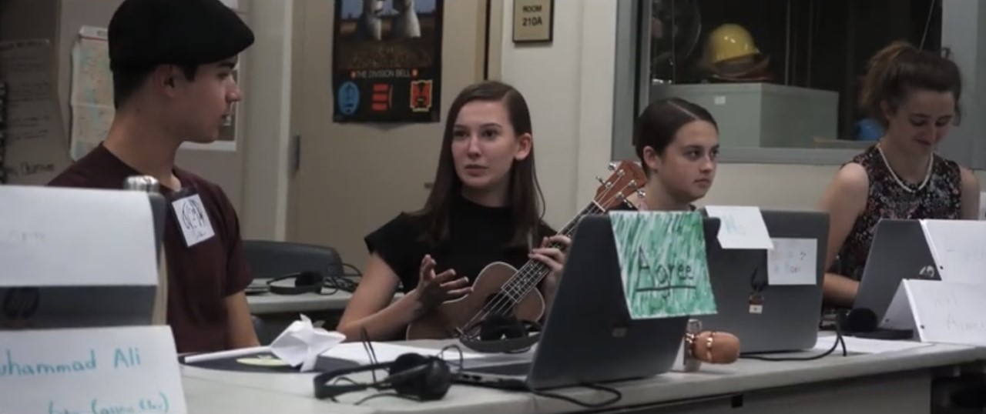
Debating Tips
Debating is all about challenging the other side, so it is important to make your voice heard. It is important to remember that you are debating as your selected person and their views NOT yours! While it may be tempting to throw in your ideas on a topic make sure you are debating as if you are that person. Your research should have enough information for you to make informed statements about your person and their beliefs.
Make sure you are being respectful about your statements but also make sure you play the part of your character. If your character is more aggressive in their points than you should be too and if they are sweeter and soft spoken, then so should you. One of the most important aspects of this project is to make sure that you embody your person and act as if you were them, make it fun!
When debating, take notes and pay attention to what everyone is saying. Always feel free to tag off what someone is saying and put it your own perspective or if your person has experience in that field then you can also mention that. If you disagree with someone, write down your points so you can use that when you refute them.

